Slide 1
Nevada ProStart Management Competition

Slide 2
Overview

Slide 3
Basics
Management Competition Flow:
Teams of 2 - 4 students plus 1 team manager
Check In:
Six (6) copies of the written proposal
Menu and Costing information in a separate manila folder
Two (2) 24 x 36 inch posters
Booth set up (5 minutes)
Five Verbal Presentations (7 minute sessions with a 3 minute break between)
Feedback (10 minutes)

Slide 4
Checklist
6 written proposals in sections separated by tabs including:
Restaurant concept description
Type of establishment, Type of cuisine served, Meals served, Hours of operation, Target market
Floorplan of selected Restaurant Space Scenario
Description of interior and décor
SWOT Analysis
Organizational Chart
Sample menu
Recipe(s) for one menu item
Costing worksheet(s) for one menu item
Menu pricing worksheet(s) for one menu item
Photo of one menu item
Two marketing tactics
Description, Goal, Budget, ROI, Sample
2 Posters: flat, no larger than 24 x 36 inches
One poster should display the sample menu and the floorplan, Second poster should display one marketing tactic
Manila Folder

Slide 5
Restaurant Concept
Type of establishment
Purpose and impact
Meals served (breakfast, lunch, dinner, etc.)
Hours of operation
Type of cuisine served
Target market within the fictional city of ProStartville
The geographic location of ProStartville, USA is at your discretion.
Population – 270,000
Median age – 33
Families – represent 29% of the population

Slide 6
Space
Students must use one of the four scenarios provided to create a unique floorplan.
Freestanding – Located in the heart of Main Street, a spot just opened up in between the county court house and the ProStartville Community Center.
Airport – Restaurant space available in the ProStartville International Airport in Concourse B after passengers pass through TSA security.
Food Truck – Perhaps the most flexible option. You are bringing the food to the masses.
Strip Mall – The strip mall is located near the large university and contains a nail salon, a craft store, a bank, and a few other new businesses opening up.

Slide 7
Organizational Chart
+ Floor Layout
Organizational Chart
Staff positions required to run your restaurant. Number of staff per position is not required.
Floor Layout
-Front of the house and back of the house

Slide 8
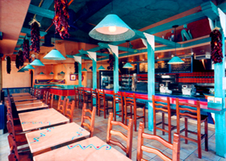
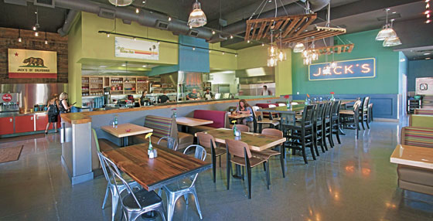
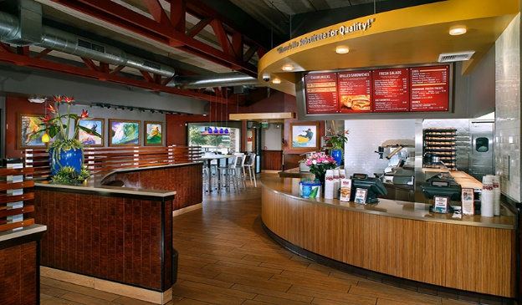
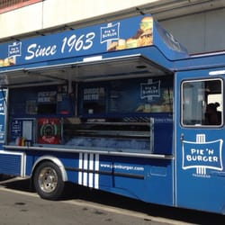
Develop Concept

Slide 9
Menu Development
Exactly 12 menu items:
-Beverages count as menu items.
-Alcohol is not allowed on the menu.
1 menu item requires:
-Recipe
-Costing
-Pricing
-Photo
Culinary and Management teams may collaborate on menu items

Slide 10
Marketing Tactics
Teams will develop two (2) marketing tactics.
Alcohol-related activities are not allowed
Services of a PR firm may not be enlisted
Website and social media presence are not tactics
Examples of acceptable samples could include
Advertising – Paying to present or promote an operation’s products, services, or identity.
Promotions – Incentives to entice customers to patronize an operation.
Public Relations – The process by which an operation interacts with the community at large.
Direct Marketing – Making a concerted effort to connect directly with a certain segment of the market.

Slide 11
Critical Thinking
The judges will present each team mini-scenarios from four of the following categories:
Social Media
Safety & Sanitation
Customer Service
Human Resources & Staffing
Marketing
Menu Development and Design
Concept Knowledge

Slide 12
Scoring
A maximum of 195 points can be earned by a team during the Management Competition.
30-concept
35-menu and Costing
40- Marketing
30-Operations
55-Critical Thinking
5-Menu and Recipe Costing___
195
In the event of a tie, the tied team with the highest number of Critical Thinking points will be awarded one (1) additional point to break the tie.

Slide 13
Warning
Pay close attention to the
rules to avoid penalties and
potential disqualification

