Slide 1
Nevada ProStart Culinary Competition

Slide 2
Basics
Venue TBC in Las Vegas on February 2nd (3rd may be added depending on registrations)
It’s FREE to compete: To avoid cancelations, we will charge $50 registration fee per student, refundable upon completion of all competition segments student has registered for.
Top team in each competition goes to the National ProStart Invitational: April 27-29, 2018, Providence, Rhode Island

Slide 3
Overview

Slide 4
Nevada ProStart Culinary Competition
Basics:
Teams of 2-4 students plus 1 team manager
Students will cook on two portable butane burners
No electric powered equipment is allowed (except battery timers, clock, thermometers and digital scales)
Teams will provide all pots, pans, small wares, side towels, etc.

Slide 5
Disqualification
Late arrival
Competing students MUST arrive at the appointed time to compete or they will be disqualified.
Coaching
Competing students and team manager MUST not receive coaching or any form of communication or they will be disqualified.
Misconduct
Failure to compete
Teams must participate in each event segment in the competition or they will be disqualified. This includes individual contests.
Failure to compete in any segment will result in disqualification.

Slide 6
Scoring
A maximum of 100 points can be earned by a team during the culinary competition.
In case of a tie: The teams that have tied will each be interviewed by a panel of judges and the culinary competition coordinator.

Slide 7
Menu
3 courses:
• Starter: soup, salad, or appetizer
• Entrée:
i. Center of the plate item: 4-6 ounces suggested
ii. Accompaniments such as vegetable or starch: 2-3 ounces each suggested
iii. Sauce
• Dessert
Teams must employ a minimum of two cooking methods from the following list:
Poach, Shallow Poach, Braise, Pan Fry, Steam, and Sauté.

Slide 8
Workspace
• Two (2) eight-foot tables set up in an “L” formation within a 10’ x 10’ space.
One speed rack and four (4) full size sheet pans
Sanitation buckets
Access to ice
Access to running water (available prior to and after the competition only)
Two Sterno Model 50108 15,000 BTU burners (or equivalent) and necessary fuel
All presentation dishes.
Teams may only use dishes and glassware provided by Event Organizers. Teams will be issued the dishes they ordered at product check-in
It is the team’s responsibility to check their dishes against their order

Slide 9
Permitted VS Prohobited
PERMITTED
• Handheld whipped cream chargers
• Butane torch for finishing any item
• Metal, stone or other types of plates or apparatus to extend the cooking surface of the burners
• Dry ice
• Audio recording device to record the critique and feedback sessions
• Additional sheet pans
• Camping oven and/or smoker attachments for provided burner
PROHIBITED
• Fueled or mechanical heat sources other than provided event burners
• MRE heater packs
• Electric, battery-operated or compressed gas devices
• Plastic or Plexiglas for the purpose of covering tables
• Cell phones, tablets, or communication devices
• Additional speed racks or equipment exceeding the external dimensions of 2 ft width x 4 ft length x 3 ft height
• Cutting guides i.e. cutting boards with rulers or other aids

Slide 10
Areas to be evaluated
Product Check-In
• Knife Skills
• Taste and finished product
• Product Taste / Finished Product
Team Presentation/Work Skills/Org.
Safety and Sanitation
Menu and Recipe Presentation

Slide 11
Checklist
Four (4) folders each containing
School Name on cover
Menu with Prices (simple typed menu 8 ½ x 11)
Knife Skills form; typed on official template
Plate Photographs
A separate color photograph for each course (Photos printed on 8 ½ x 11 pages)
Recipes; typed on official template
Recipe costing sheets; typed on official template
Menu Price Sheets; typed on official templates
Other items
Complete printed list of the contents of each cooler or container on the inside and outside of each cooler or container in a plastic sleeve
Loose Knife Skills sheet with the four chosen knife cuts available for floor judges
One copy of Presentation Menu; framed

Slide 12
Warning
Pay close attention to the
rules to avoid penalties and
potential disqualification

Slide 13
Timing
The timer is the expediter for the competition
Time: Timer Rules!
Rules: Judges Rule!

Slide 14
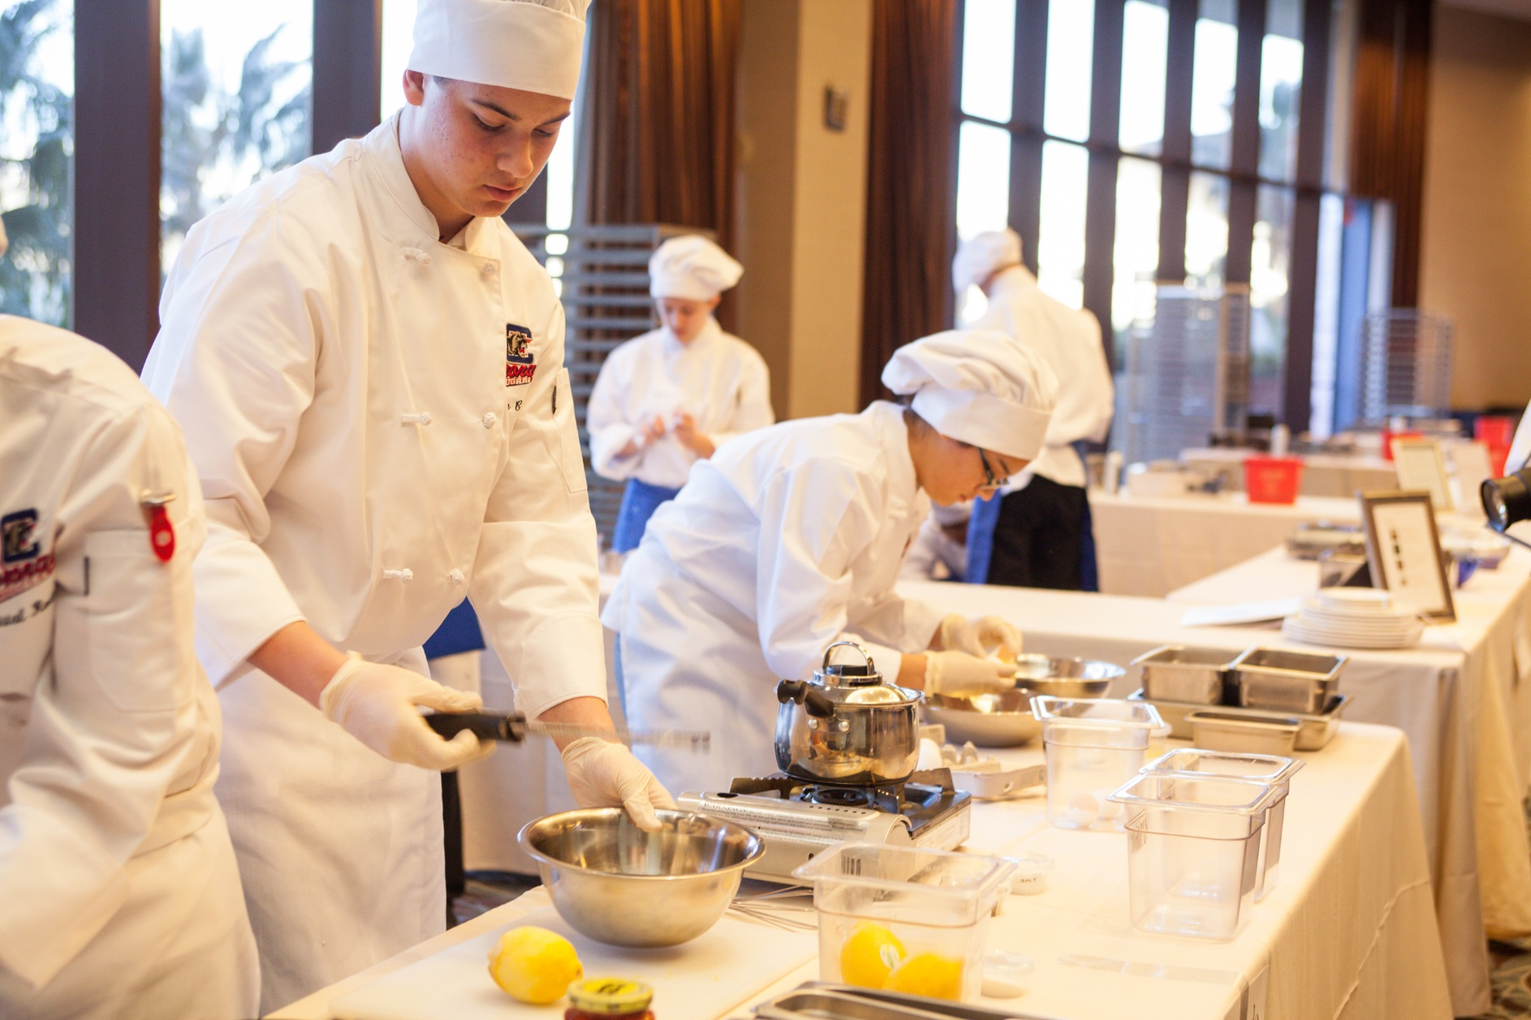
Nevada ProStart Culinary Competition 2017

Slide 15
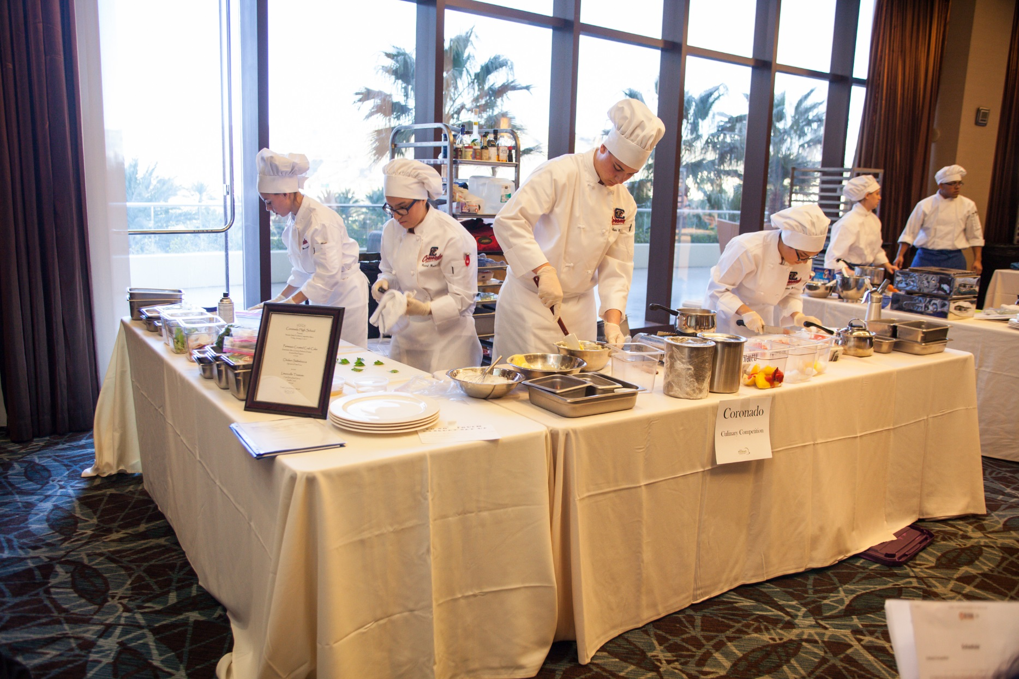
Nevada ProStart Culinary Competition 2017

Slide 16
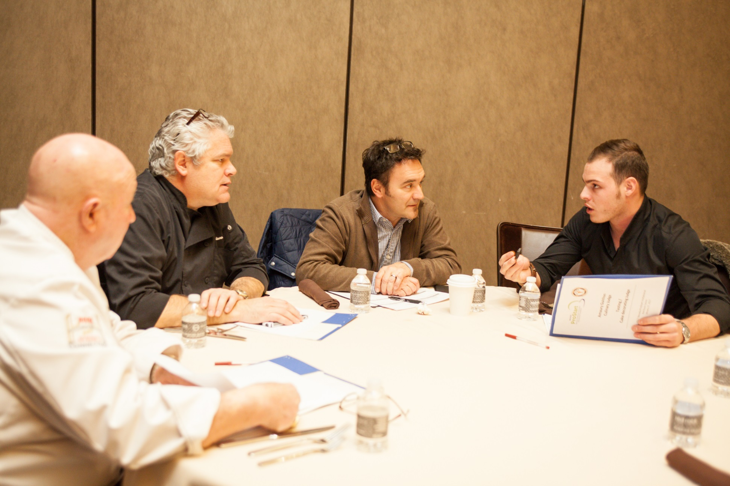
Nevada ProStart Culinary Competition 2017

Slide 17
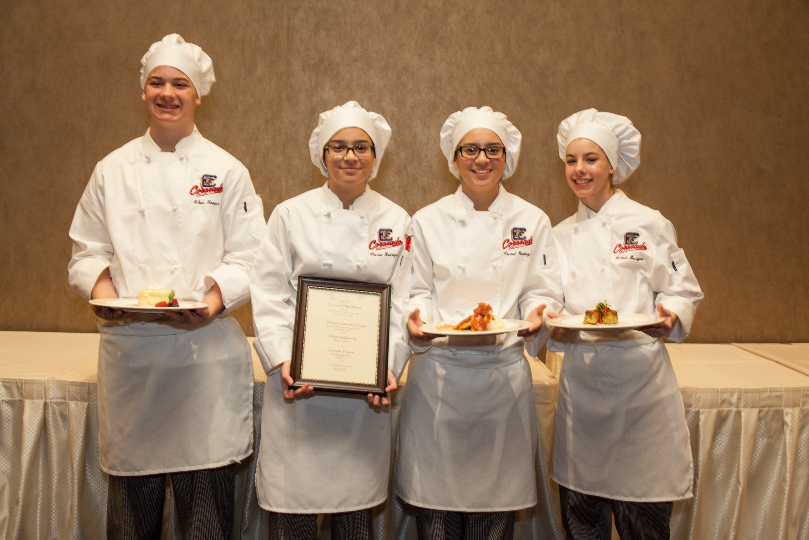
Nevada ProStart Culinary Competition 2017

Slide 18
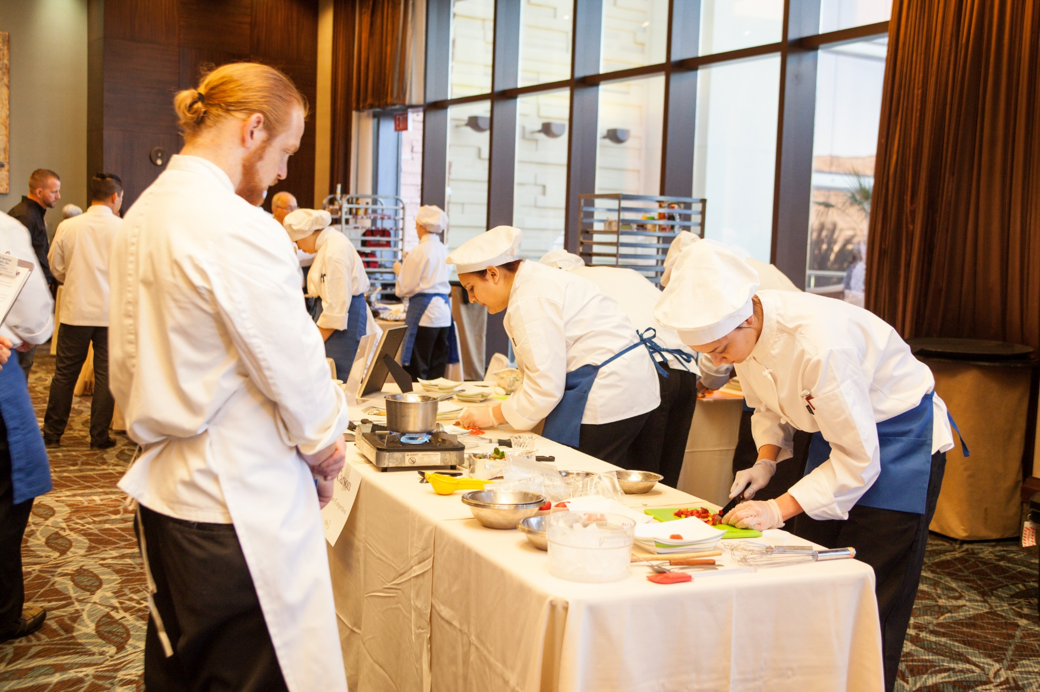
Nevada ProStart Culinary Competition 2017

